Slide 1

FLIGHT PRICE PREDICTION PROJECT
Submitted by:
ANISH ANTONY

Slide 2
ABSTRACT:
Traveling in an airplane is one of the most exciting and expensive modes of travel. Since it is expensive, we must plan well accordingly. In this project we will see how the ticket vary based on advance booking of the flight and also how the price varies as the dates come closer. In this project we will be predicting the flight price from machine learning models. To predict this model, we need to scrape the flight booking details for two months from online websites using selenium web driver, and the data have preprocessed, trained and tested using the regression algorithms. Then it is hypertuned and best algorithm with best parameters is obtained and finally the ticket price of the flight is predicted.
Keywords: Flight ticket ,Selenium ,Data cleaning ,Ticket Price ,Regression

Slide 3
The features used in the dataset are:
Flight Company
Flight No
Flight Class
Flight Model
Travel
Departure Time
Departure Day
Departure Date
Departure Month
Departure Duration
Arrival Time
Arrival Day
Meal
Flight Ticket Price
Luggage
Connecting Planes
No of days

Slide 4
Data Cleaning:
Flight Company – Grouped as str
Flight No – Grouped as str
Flight Class – Grouped as str
Flight Model – Grouped as str
Travel – Combined source and destination grouped as str
Departure Time – Converted to hours
Departure Day – Grouped as str
Departure Date – Grouped as str
Departure Month – Grouped as str
Departure Duration – Converted to minutes as int
Arrival Time – Grouped as str
Arrival Day – Grouped as str
Meal – Grouped as str
Flight Ticket Price – Grouped as int
Luggage – Grouped as str
Connecting Planes – Grouped as str
No of days – Grouped as int

Slide 5
Dataset Description:
Columns | Datatype | Unique values | Mode Mean | Values
1 | Flight Company | object | 9 | Vistara Premium Economy
2 | Flight No | object | 446 | UK832
3 | Flight Class | object | 3 | Economy
4 | Flight Model | object | 19 | Vistara, Airbus A32-100
5 | Travel | object | 6 | Bengaluru to Mumbai
6 | Departure Time | object | 22 | 7
7 | Departure Day | object | 7 | Sat
8 | Departure Date | object | 28 | 29
9 | Departure Month | object | 2 | Aug
10 | Departure Duration | int32 | 68 | 126.74935
11 | Arrival Time | int32 | 23 | 15.164451
12 | Arrival Day | object | 7 | Sat
13 | Meal | object | 2 | Free Meal
14 | Flight Ticket Price | int64 | 652 | 19838.348439
15 | Luggage | object | 5 | 15
16 | Connecting Planes | object | 3 | Has one connecting plane
17 | No of days | int32 | 5 | 19.52242

Slide 6
Hardware and Software Requirements and Tools Used:
Hardware – PC Windows 10, 4 GB Ram
Software – Google chrome, MS Excel, Python, Selenium webdriver
Libraries – Pandas, NumPy, Matplotlib, Seaborn, sklearn, SciPy. Stats
Browsing – Google Chrome
Webscraping – Python, Selenium webdriver
Data cleaning – Python, Pandas, NumPy & SciPy. Stats
Data visualization – Matplotlib & Seaborn
Machine learning – Sklearn

Slide 7
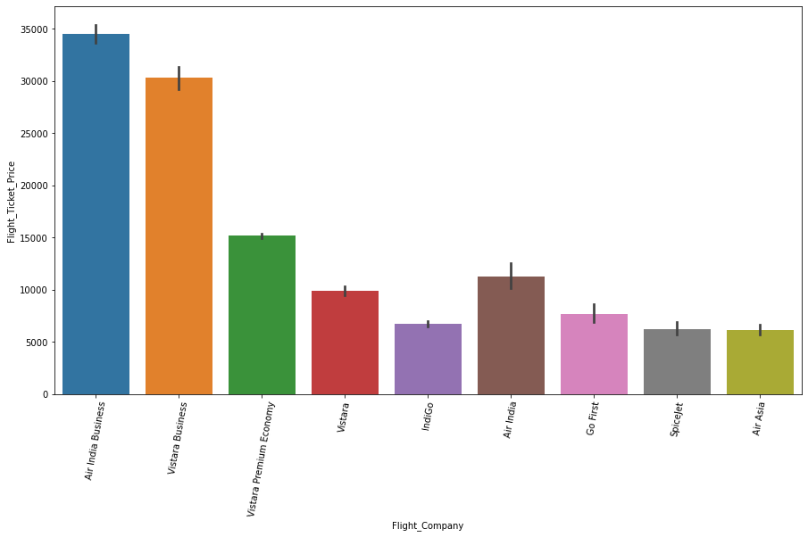
Flight Company :

Slide 8
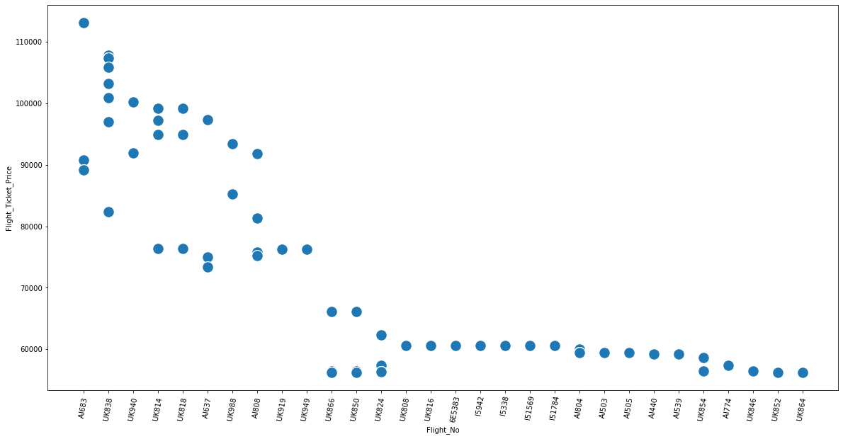
Flight No:

Slide 9
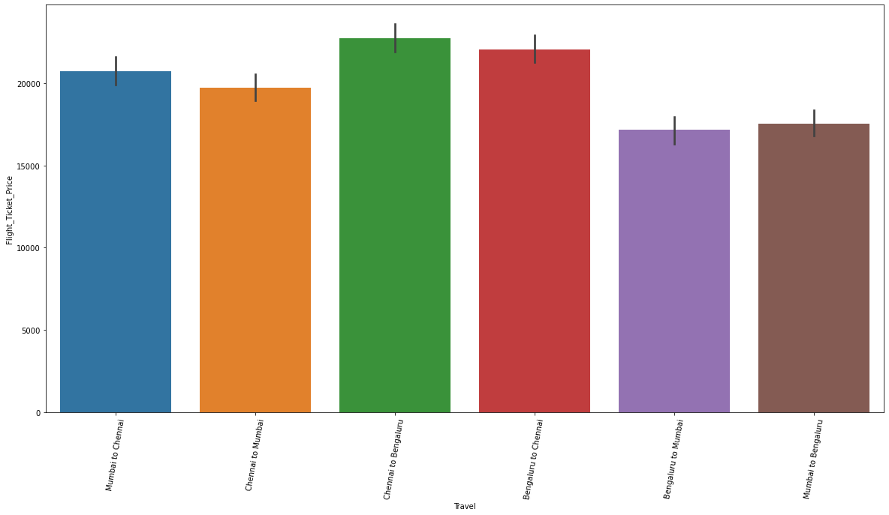
Travel:

Slide 10
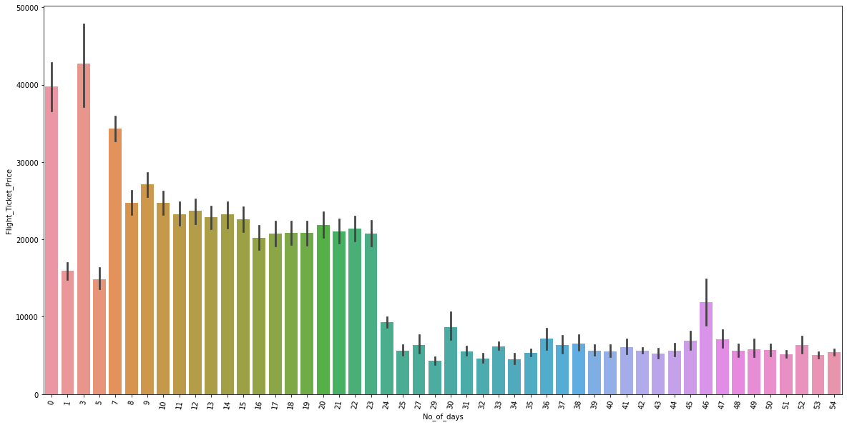
No of days:

Slide 11
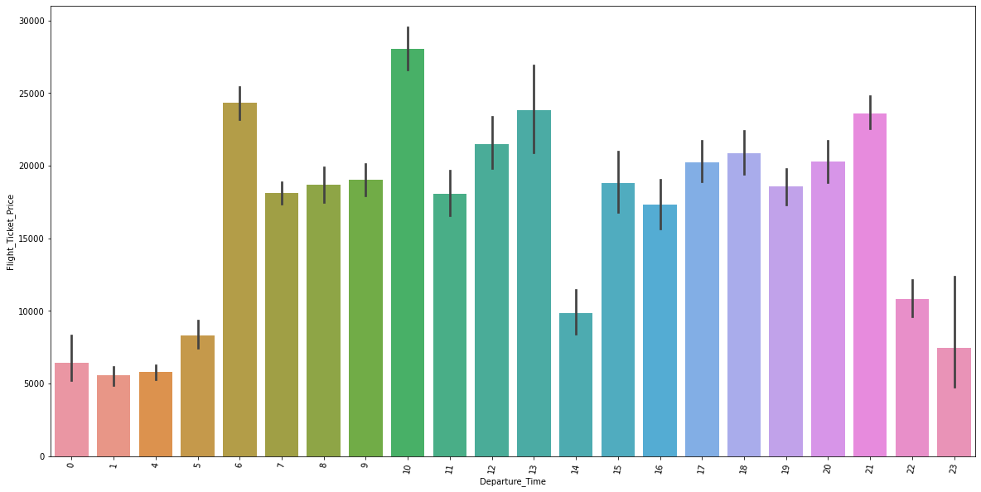
Departure Time:

Slide 12
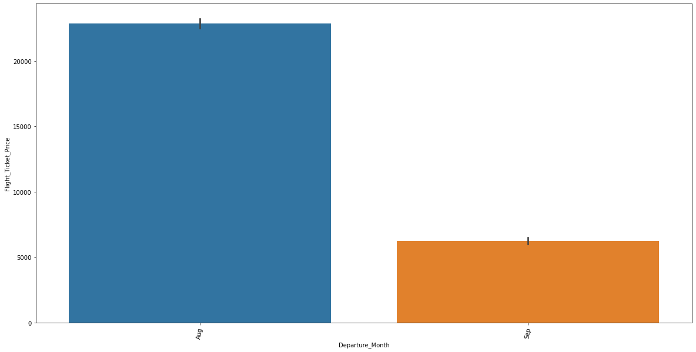
Departure Month:

Slide 13
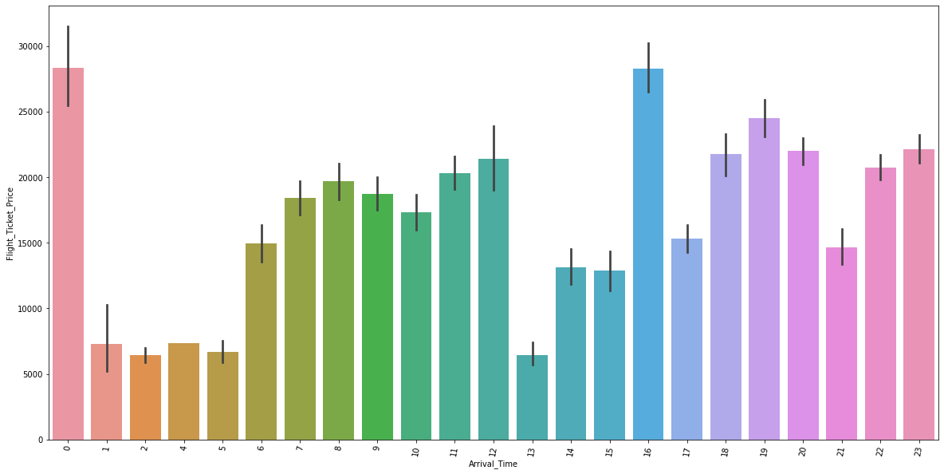
Arrival Time:

Slide 14
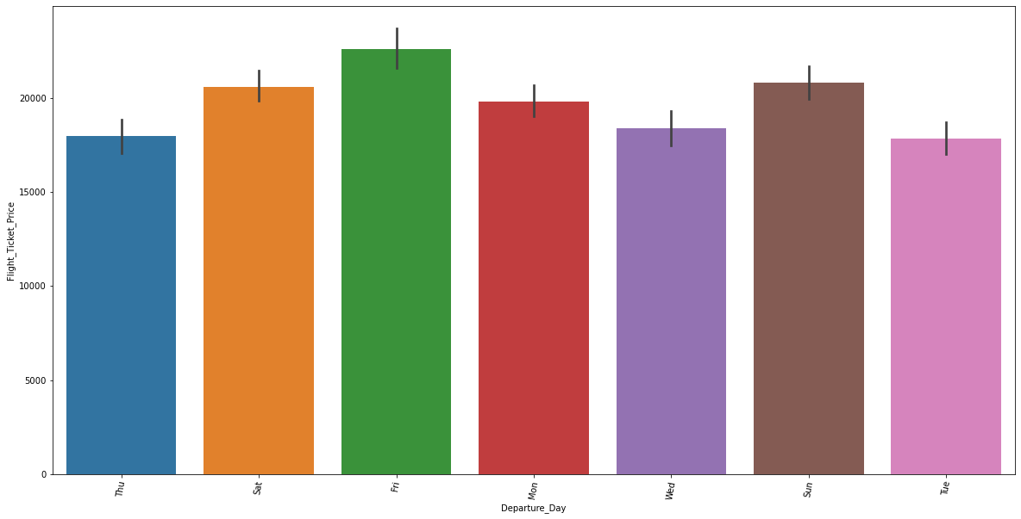
Departure Day:

Slide 15
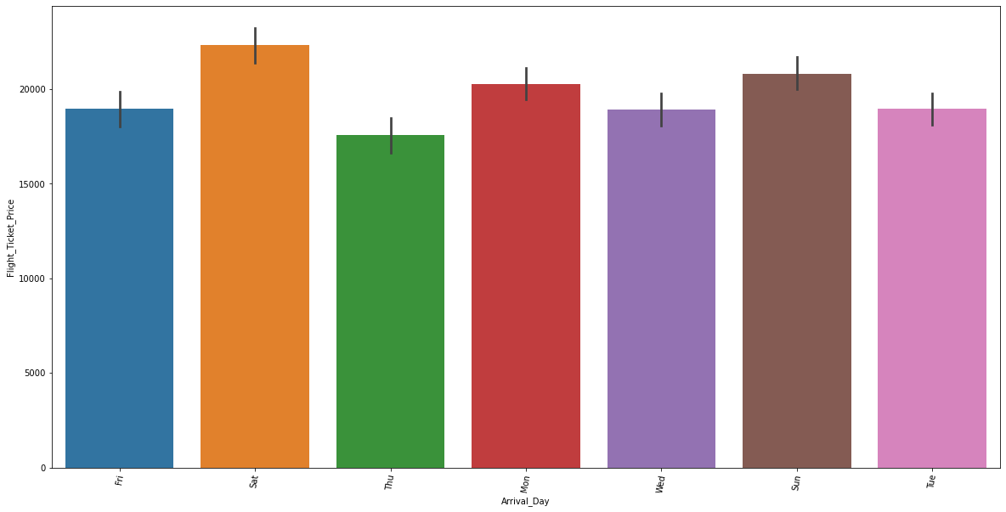
Arrival Day:

Slide 16
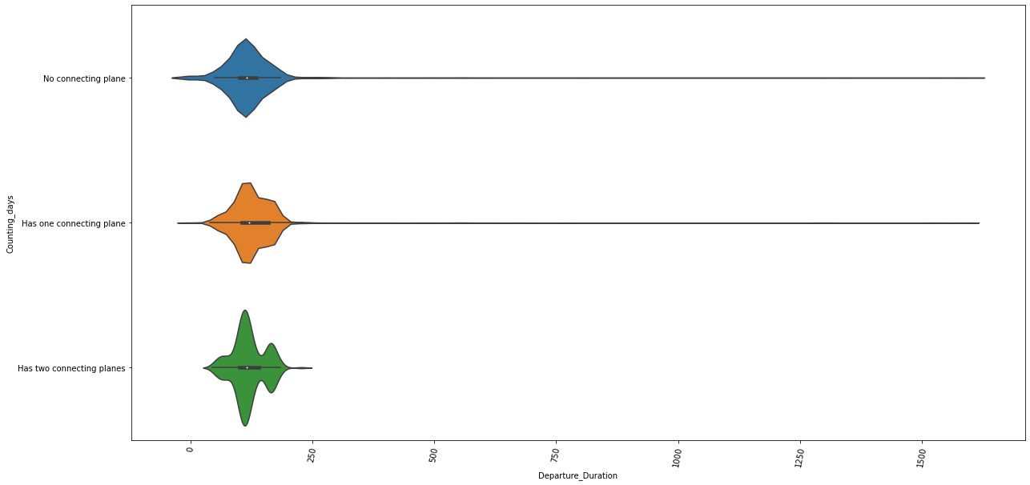
Duration:

Slide 17
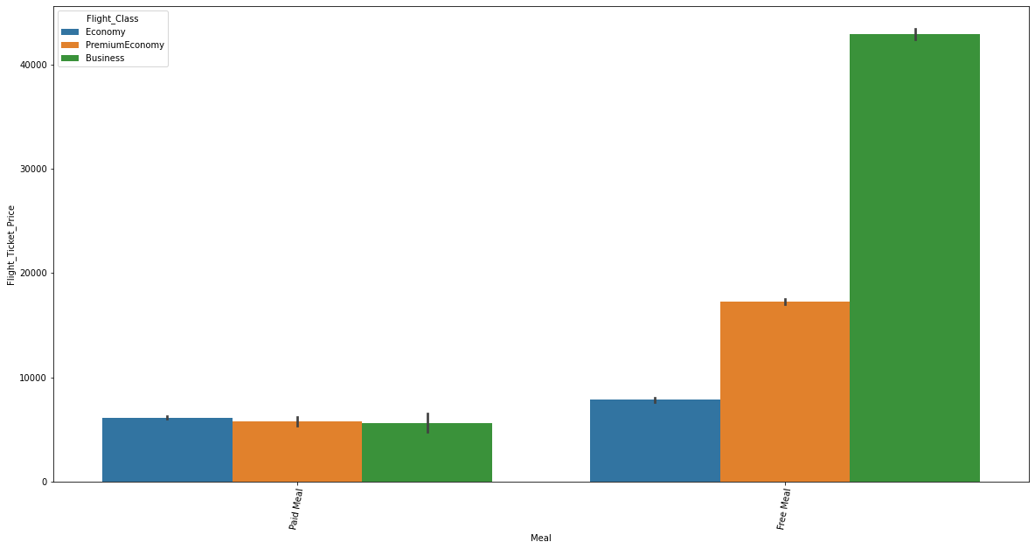
Meal:

Slide 18
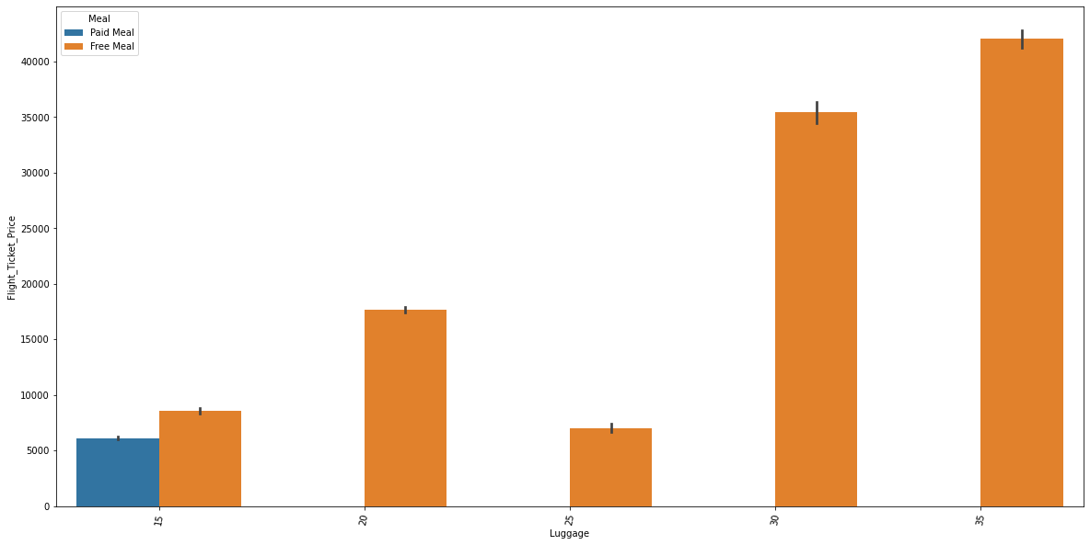
Luggage:

Slide 19
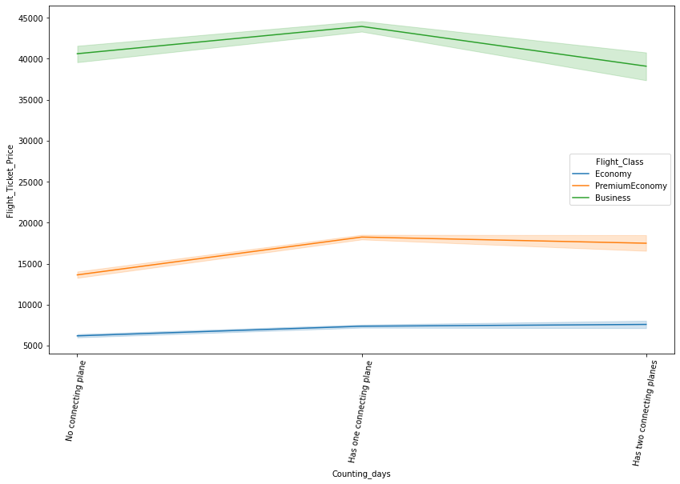
Connecting Flights:

Slide 20
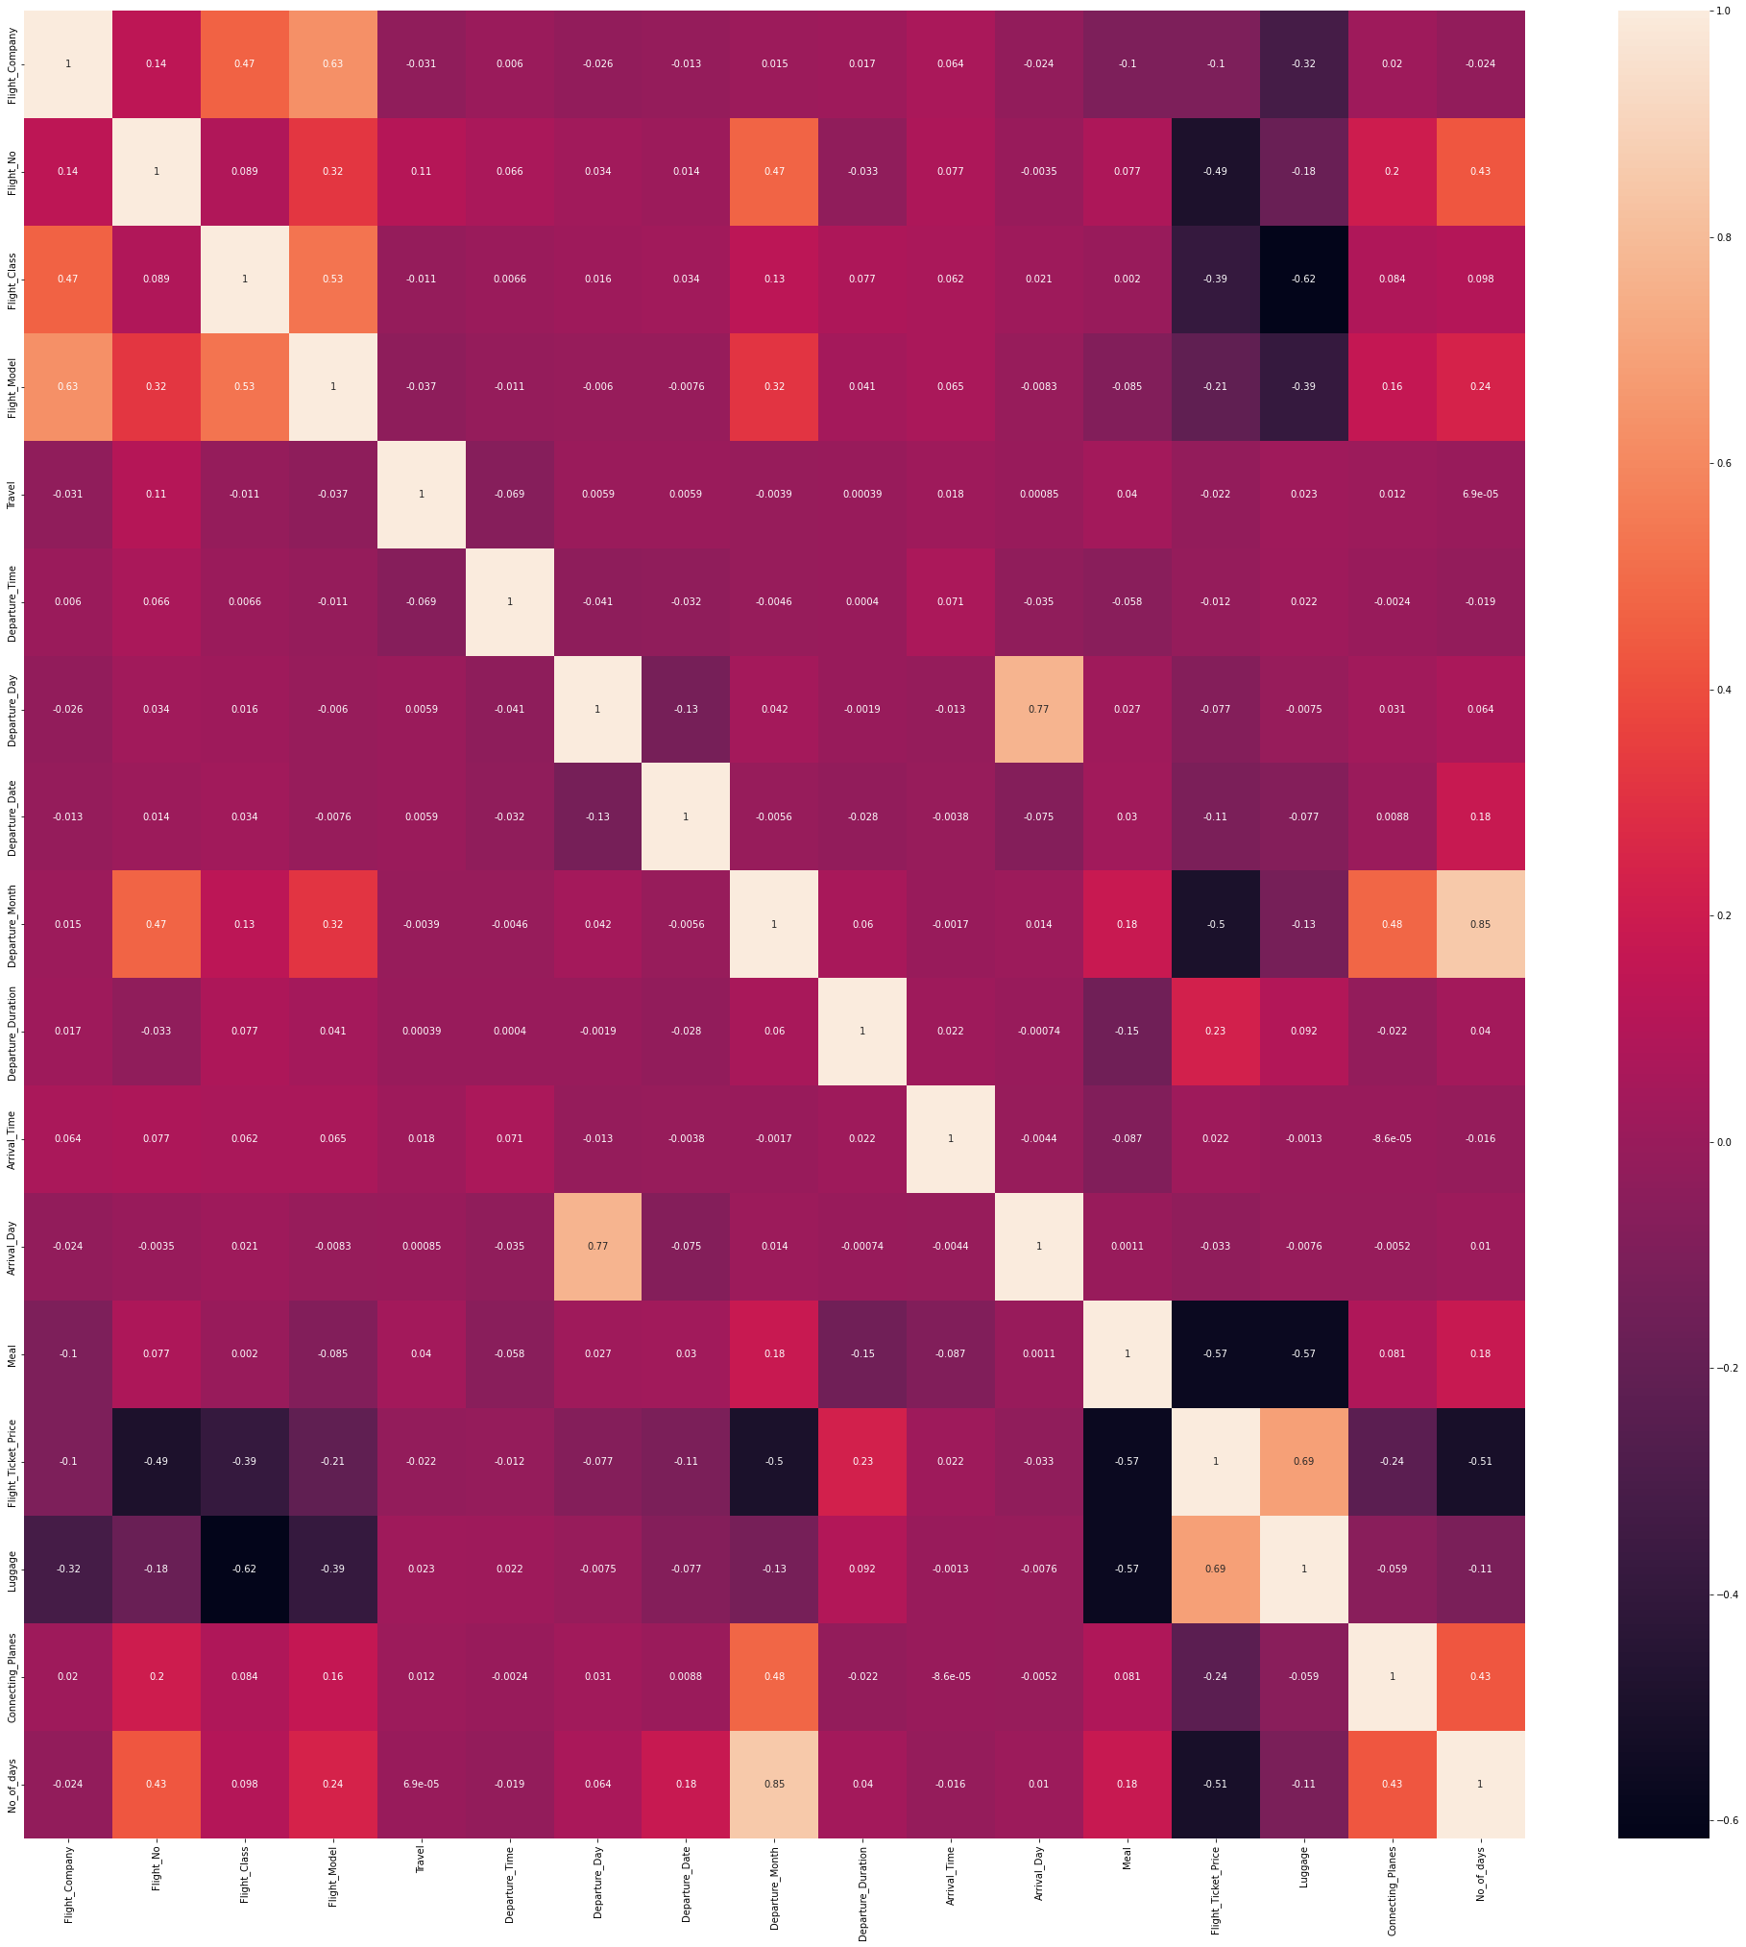
Heatmap:

Slide 21
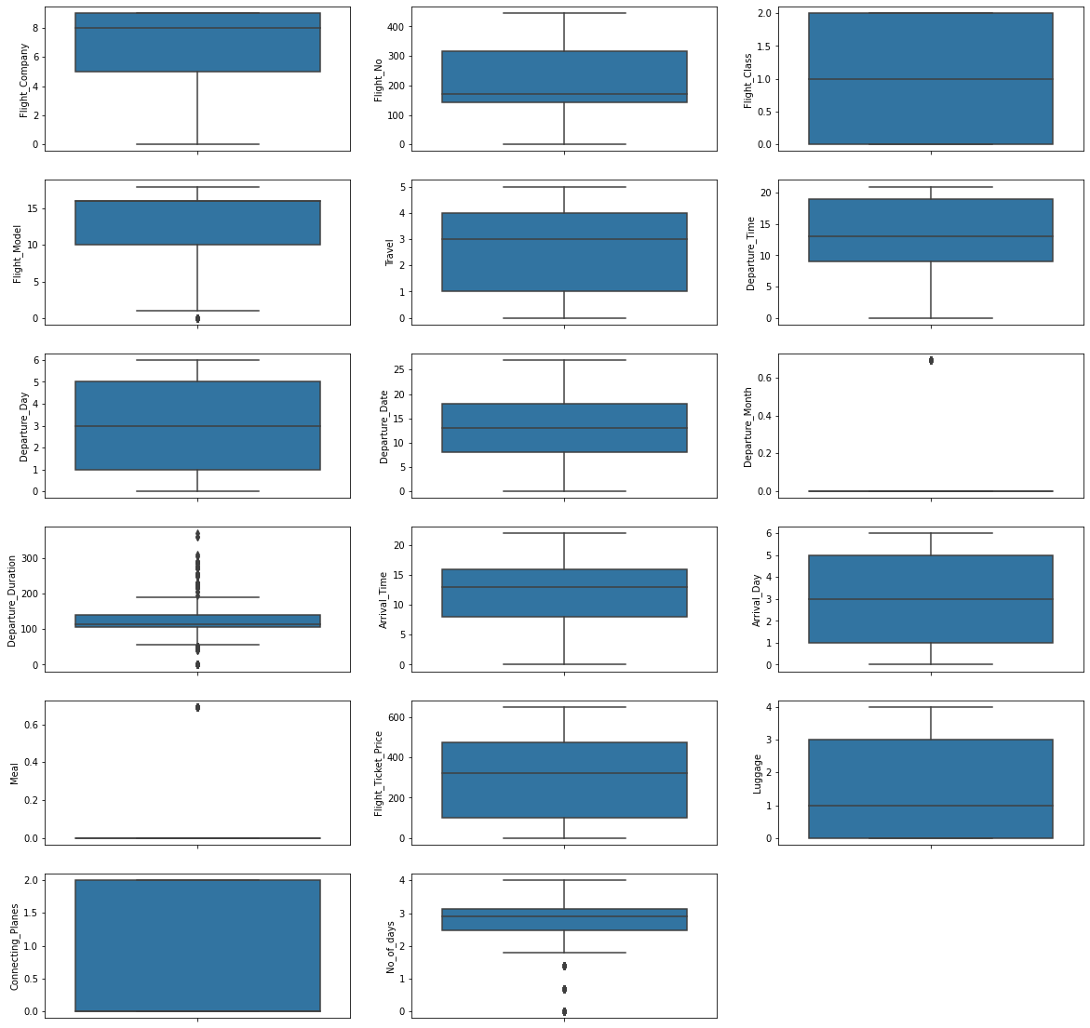
Boxplot:

Slide 22
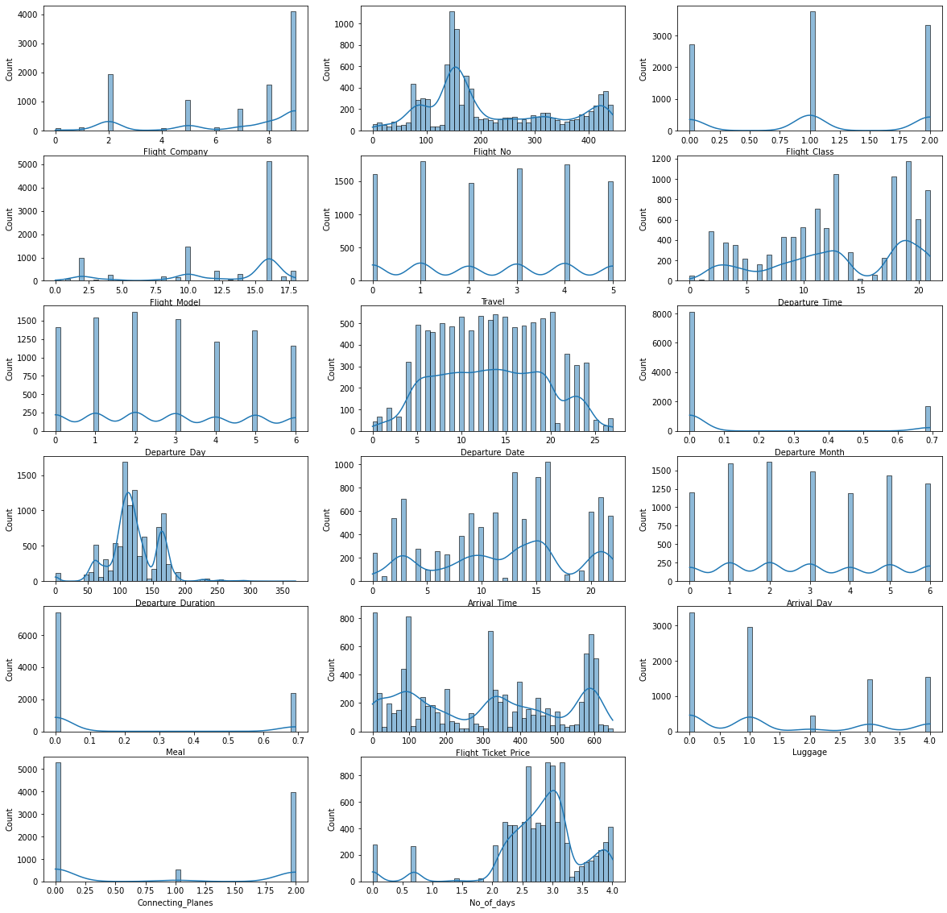
Histogram:

Slide 23
Testing of Identified Approaches (Algorithms):
Linear Regression
Gradient Boosting Regressor
AdaBoost Regressor
Decision Tree Regressor
KNeighbors Regressor
Extra Trees Regressor
Random Forest Regressor

Slide 24
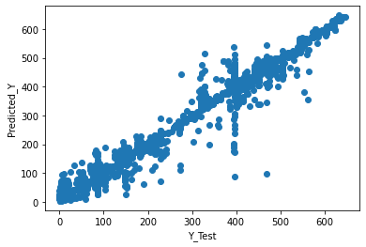
Y test plot:

Slide 25
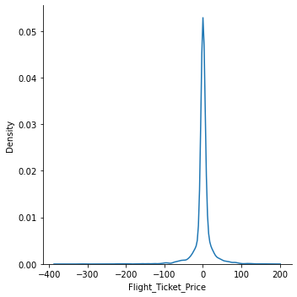
Distribution of Predicted Values:

Slide 26
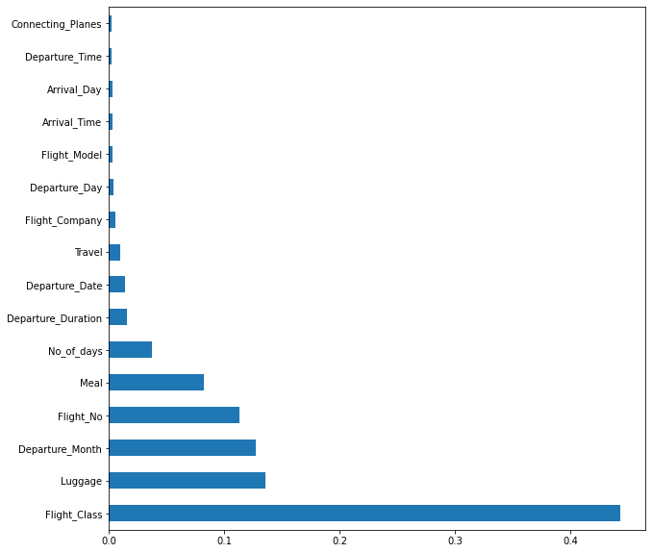
Feature importance’s

Slide 27
Accuracy Parameter:
R2 Score: 98.48414998011373
Mean Absolute Error: 10.476769408502774
Extra Forest Regression gives an R2 score 0.98
Flight class dominates the flight price more.

Slide 28
Key Findings and Conclusions of the Study:
This dataset has been taken from 2 websites of this, Yatra and MakeMyTrip constitutes the majority of data
Since the target feature is continuous data, this problem can be solved by regression algorithms
Extra Forest Regression gives an R2 score 0.98
Flight class dominates the flight price more.

